Slide 2
Content
Introduction
Overview
Sailboat Simulation
Motion Control System
Future Work

Slide 3
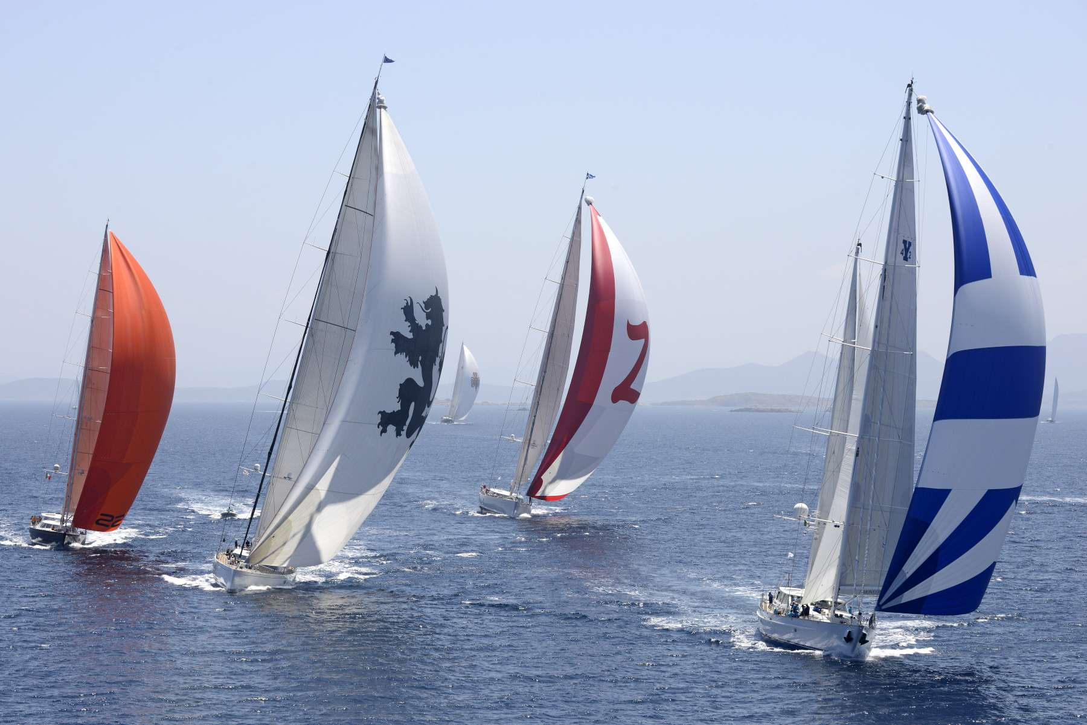
Introduction
Unmanned wind-powered autonomous surface vehicle (ASV)
Oceanographic research
Low-power Consumption
Introduction
Overview
Sailboat Simulation
Motion Control
Future Work

Slide 4
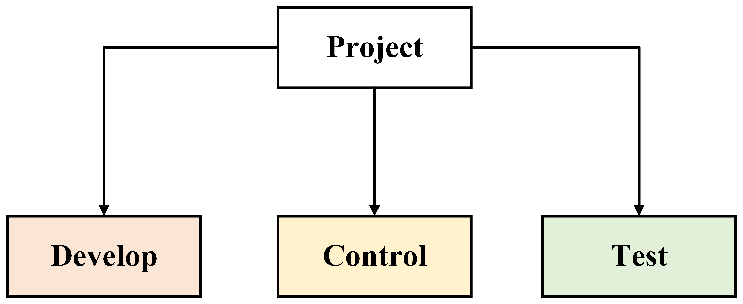
Overview
Research Goal: Develop a sailboat control system and platform capable of sailing a predefined course
Introduction
Overview
Sailboat Simulation
Motion Control
Future Work

Slide 5
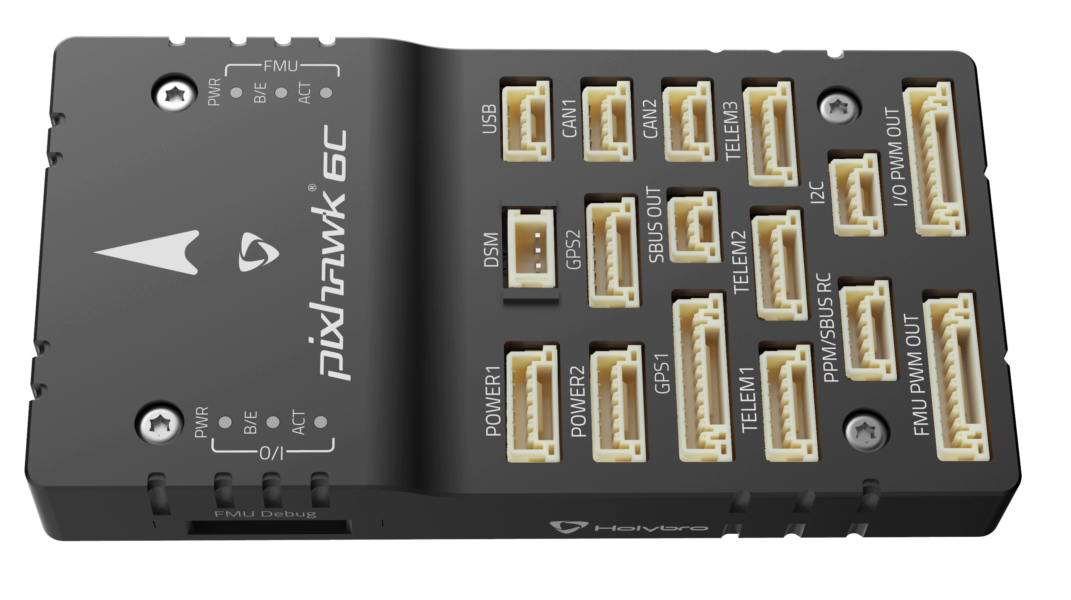

Overview: Develop
Develop non-linear physics simulator of a sailboat with navigation and motion control systems in Simulink
Develop hardware platform to test control strategies
Developed the needed code to test and execute control systems on hardware
The hardware: Pixhawk 6C flight controller running Ardupilot’s Rover framework with a custom wind direction and speed sensor
Introduction
Overview
Sailboat Simulation
Motion Control
Future Work

Slide 6
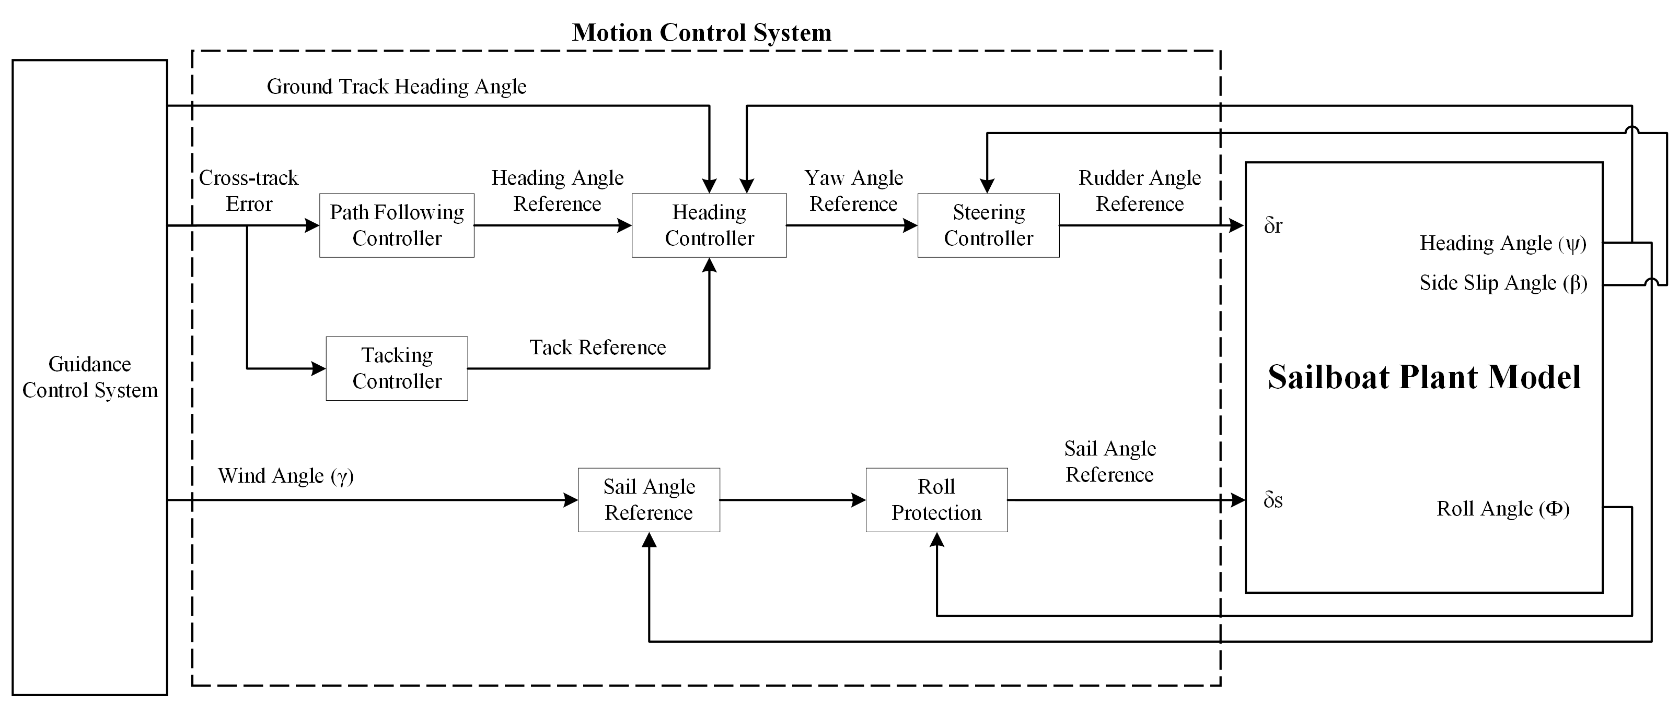
Overview: Control
Research and design navigation control systems
Research and design motion control systems capable of stabilizing, propelling and steering a sailboat
Develop multiple high level manoeuvring strategies
Introduction
Overview
Sailboat Simulation
Motion Control
Future Work

Slide 7
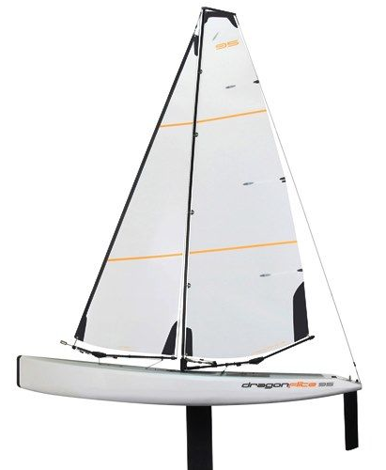
Overview: Test
Dragonflite 95 Sailboat, 1m long RC Sailboat
Lightweight and Durable hull
Two actuators (rudder & sail)
Testing pipeline
Simulink (Linear &
Non-Linear)
Ardupilot’s SITL
Actual Sailboat
Introduction
Overview
Sailboat Simulation
Motion Control
Future Work

Slide 8
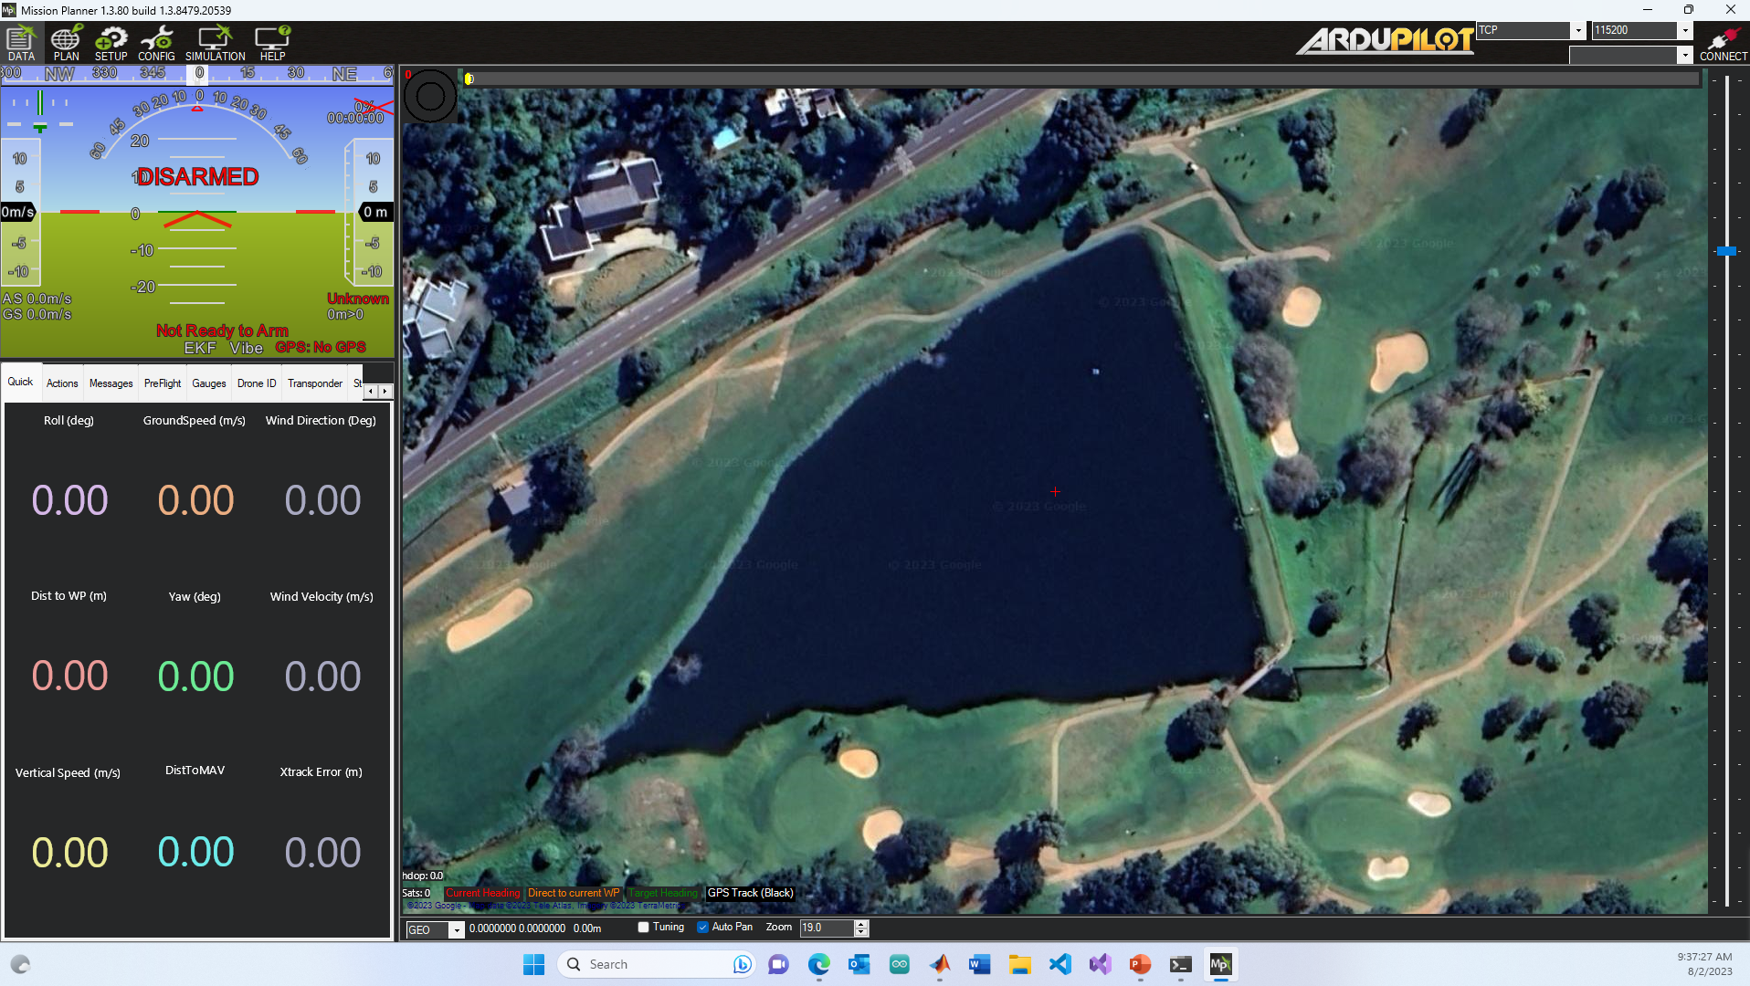
Overview: Control Platform
Mission Planner will be used as a control platform (built by Ardupilot)
Flash custom firmware to Pixhawk controller, test firmware in a SITL environment and monitor sailboat
Introduction
Overview
Sailboat Simulation
Motion Control
Future Work

Slide 9
Overview: Racecourse
Racecourse
Introduction
Overview
Sailboat Simulation
Motion Control
Future Work
Start Line
Sailboat
Upwind Waypoint
Downwind Gate
Wind Direction

Slide 10
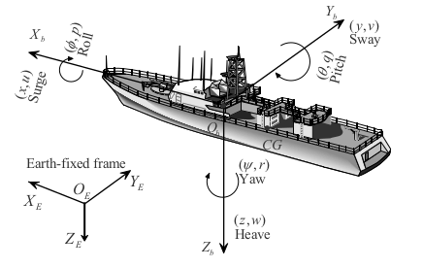
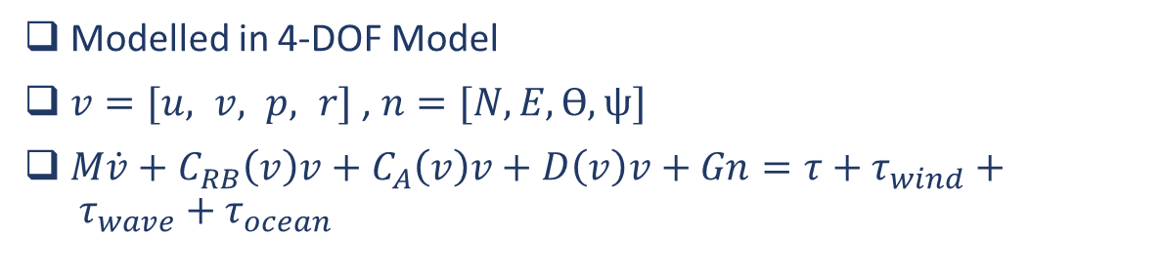
Sailboat Simulation
Modelled in 4-DOF Model
$v=[u, v, p, r]$ , $n=[N, E, ϴ, ψ]$
$M\dot{v}+C_{RB}\left(v\right)v+C_{A}\left(v\right)v+D\left(v\right)v+Gn=τ+τ_{wind}+ τ_{wave}+τ_{ocean}$
Introduction
Overview
Sailboat Simulation
Motion Control
Future Work

Slide 11
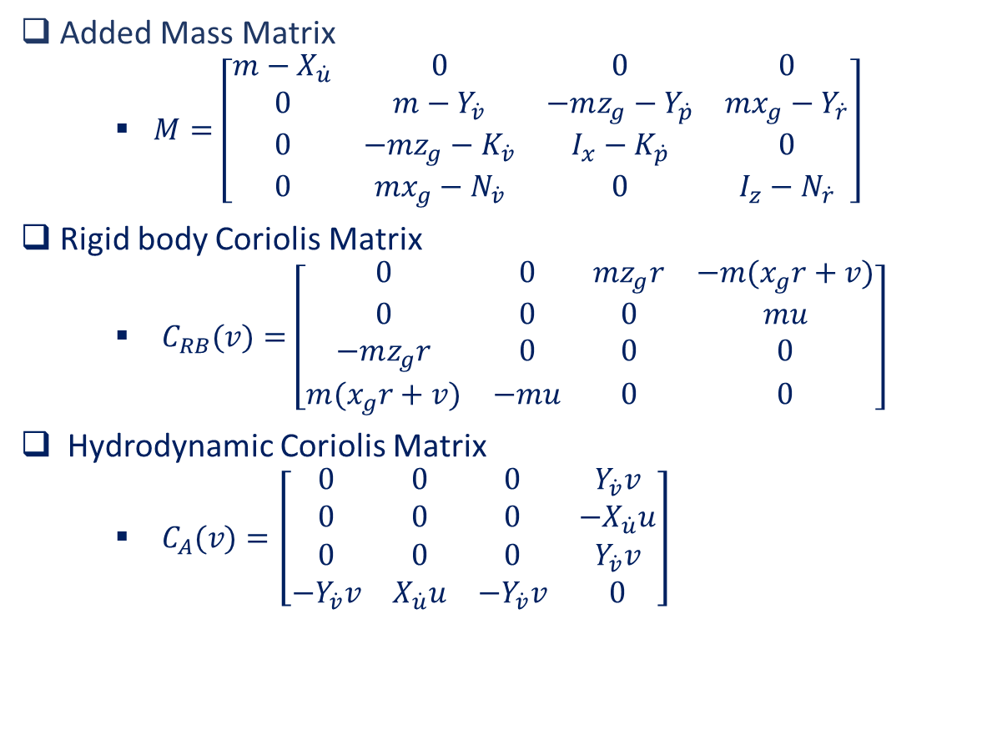
Sailboat Simulation
Added Mass Matrix
$M=\left[\begin{matrix}m−X_{\dot{u}} & 0 & 0 & 0 \\ 0 & m−Y_{\dot{v}} & −mz_{g}−Y_{\dot{p}} & mx_{g}−Y_{\dot{r}} \\ 0 & −mz_{g}−K_{\dot{v}} & I_{x}−K_{\dot{p}} & 0 \\ 0 & mx_{g}−N_{\dot{v}} & 0 & I_{z}−N_{\dot{r}}\end{matrix}\right]$
Rigid body Coriolis Matrix
$C_{RB}(v)=\left[\begin{matrix}0 & 0 & mz_{g}r & −m(x_{g}r+v) \\ 0 & 0 & 0 & mu \\ −mz_{g}r & 0 & 0 & 0 \\ m(x_{g}r+v) & −mu & 0 & 0\end{matrix}\right]$
Hydrodynamic Coriolis Matrix
$C_{A}(v)=\left[\begin{matrix}0 & 0 & 0 & Y_{\dot{v}}v \\ 0 & 0 & 0 & −X_{\dot{u}}u \\ 0 & 0 & 0 & Y_{\dot{v}}v \\ −Y_{\dot{v}}v & X_{\dot{u}}u & −Y_{\dot{v}}v & 0\end{matrix}\right]$
Introduction
Overview
Sailboat Simulation
Motion Control
Future Work

Slide 12

Sailboat Simulation
Linear Damping Matrix
$D(v)=\left[\begin{matrix}X_{u} & 0 & 0 & 0 \\ 0 & Y_{v} & 0 & 0 \\ 0 & 0 & 0 & 0 \\ 0 & 0 & 0 & N_{r}\end{matrix}\right]$
Restoration Matrix
$G\left(n\right)=\left[\begin{matrix}0 & 0 & 0 & 0 \\ 0 & 0 & 0 & 0 \\ 0 & 0 & −K_{∅} & 0 \\ 0 & 0 & 0 & 0\end{matrix}\right]$
Introduction
Overview
Sailboat Simulation
Motion Control
Future Work

Slide 13
Sailboat Simulation
Assumptions
The sailboat is assumed to be rigid with 4-DOF: surge, sway, roll and yaw motions
The sails are combined into one effective sail area
The sail, keel and rudder is modelled as rigid foils and computed independently
Friction forces are considered as linear damping elements
Added mass and Coriolis coefficients are modelled as constants
Environmental forces are modelled
Servo motor delays for the sail and rudder is modelled
Environmental Forces
Waves
Wind
Ocean Currents
Introduction
Overview
Sailboat Simulation
Motion Control
Future Work
[Modeling and Nonlinear Heading Control for Sailing Yachts, L. Xiao and J. Jouffroy]

Slide 14
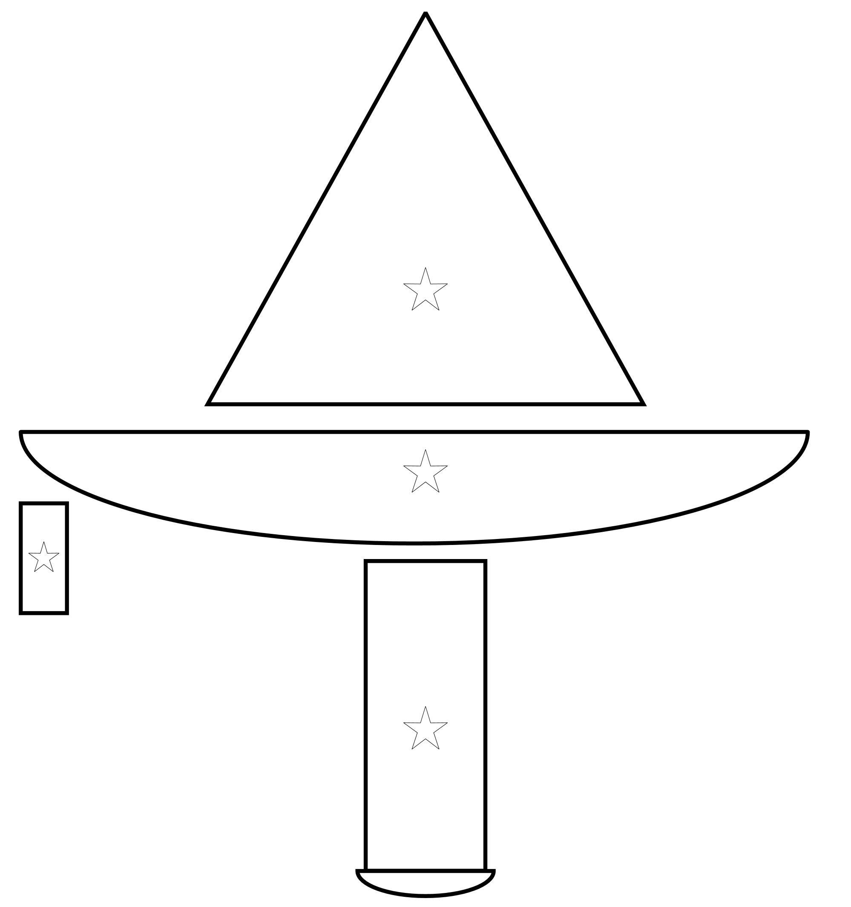
Sailboat Simulation
Introduction
Overview
Sailboat Simulation
Motion Control
Future Work
Sail
Hull
Rudder
Keel

Slide 15
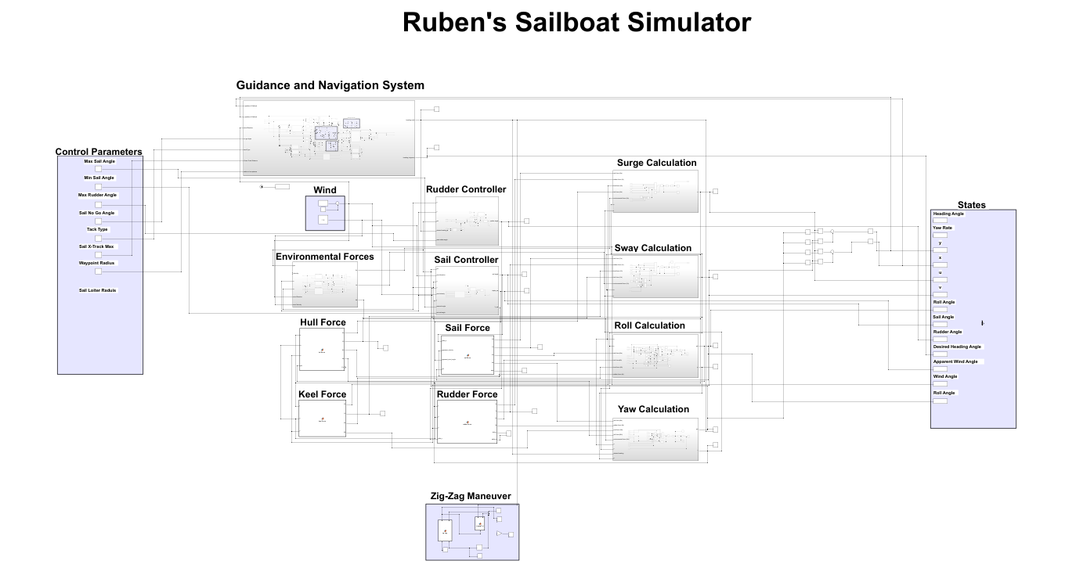
Sailboat Simulation
Introduction
Overview
Sailboat Simulation
Motion Control
Future Work

Slide 16
Motion Control System
Introduction
Overview
Sailboat Simulation
Motion Control
Future Work

Slide 17
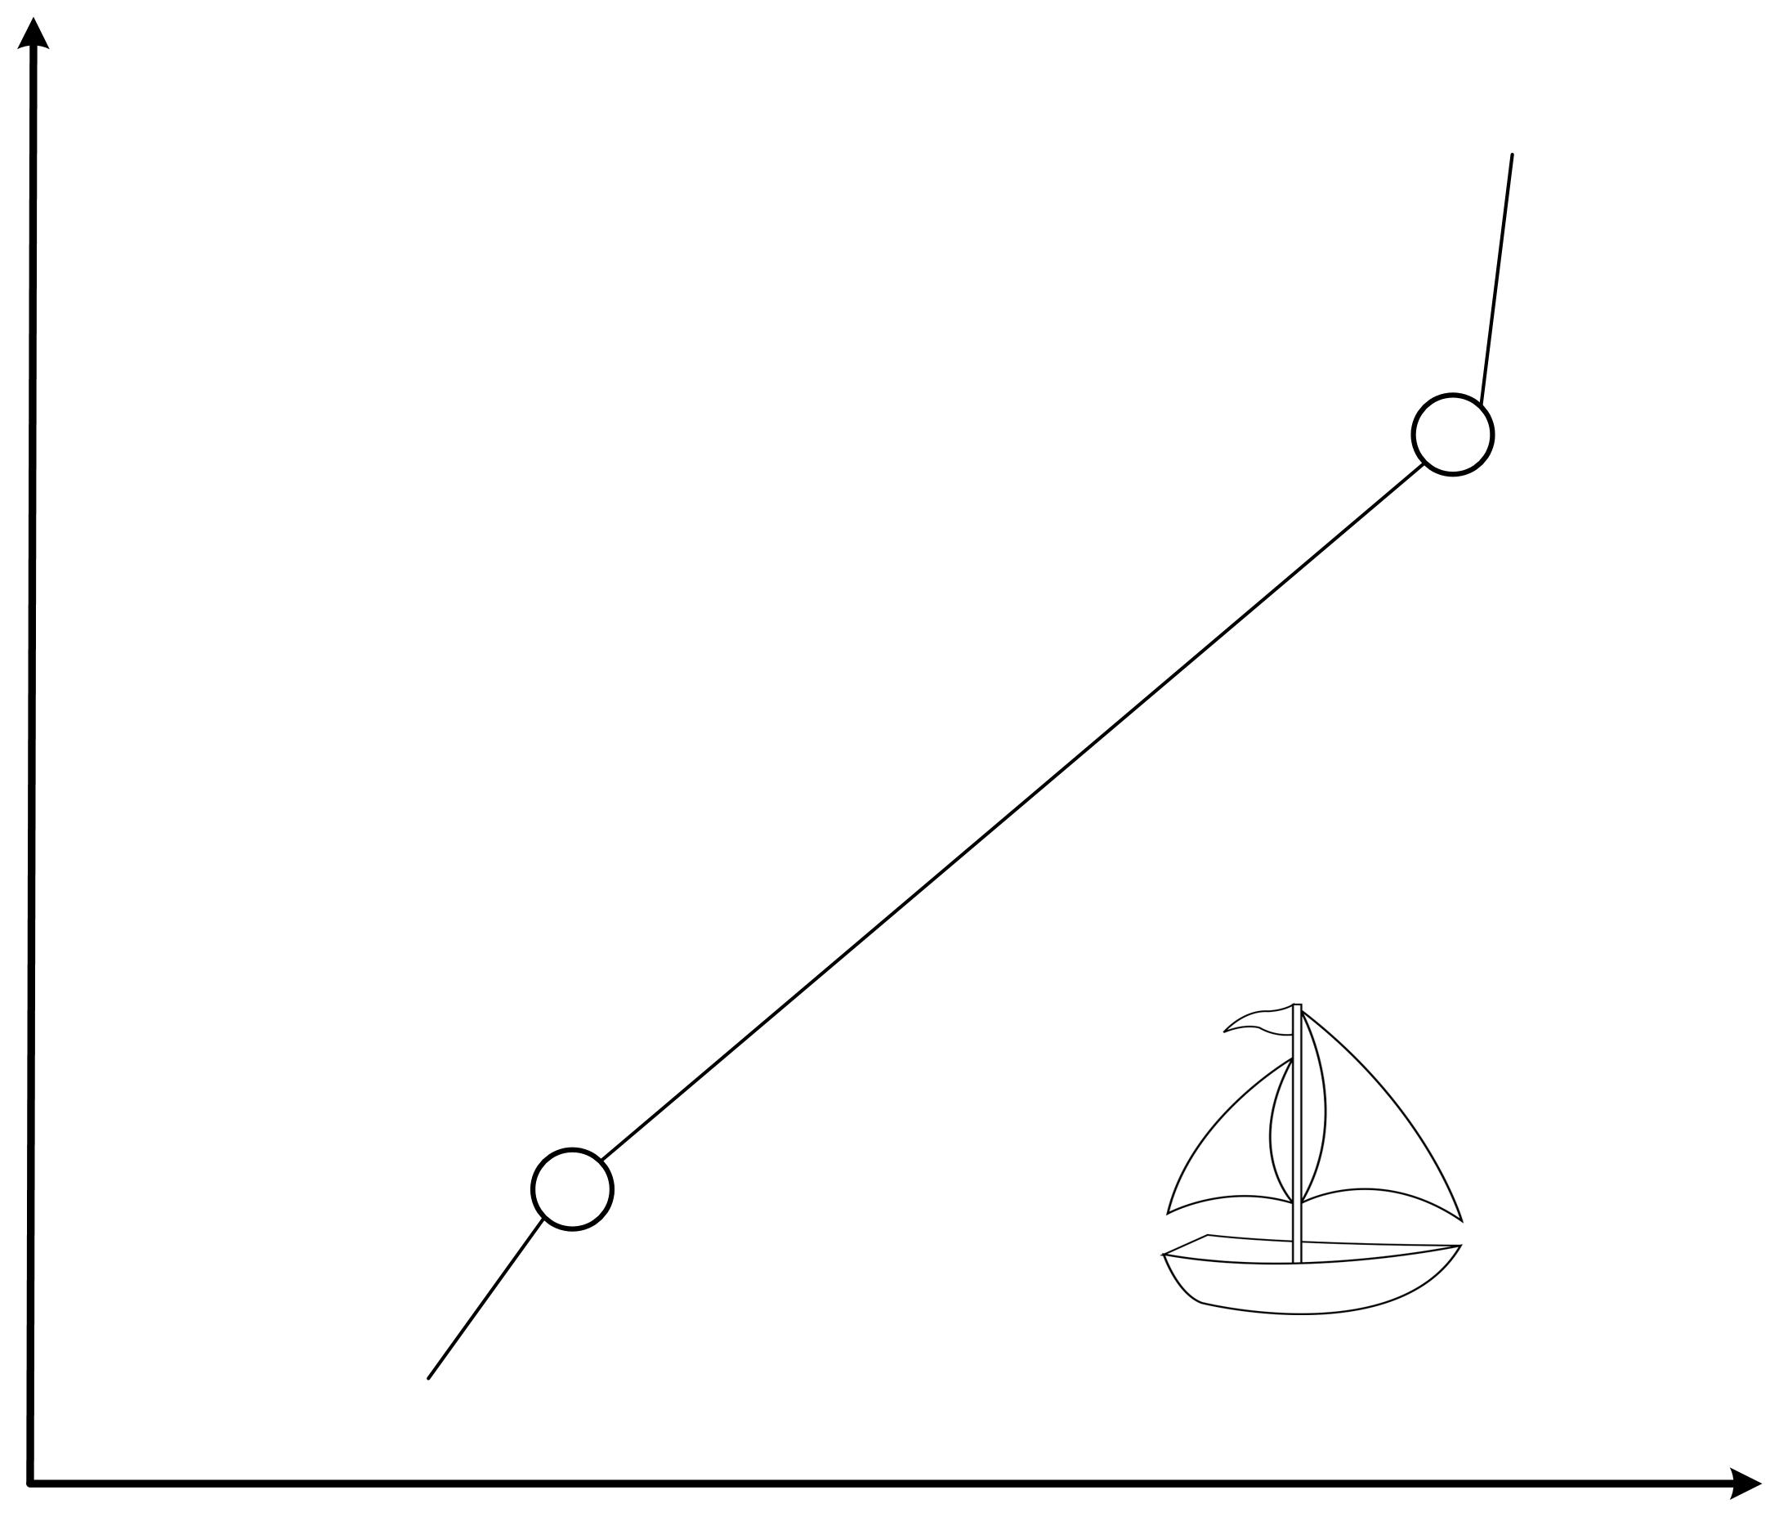
Motion Control System
Introduction
Overview
Sailboat Simulation
Motion Control
Future Work
N
Wind Direction (North-to-South)
Destination waypoint
(Ed, Nd)
ground track heading angle
Cross-track
(Es, Ns)
Source waypoint
(E, N)
E

Slide 18
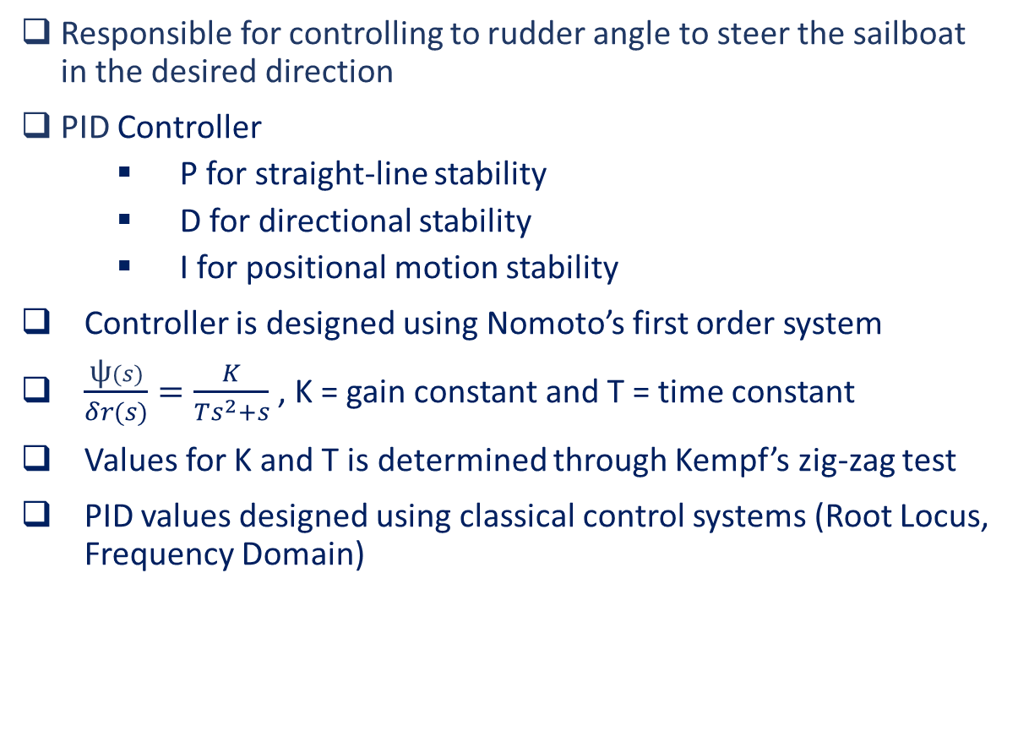
Motion Control: Steering Controller
Responsible for controlling to rudder angle to steer the sailboat in the desired direction
PID Controller
P for straight-line stability
D for directional stability
I for positional motion stability
Controller is designed using Nomoto’s first order system
$\frac{\text{ψ}(s)}{δr(s)}=\frac{K}{Ts^{2}+s}$ , K = gain constant and T = time constant
Values for K and T is determined through Kempf’s zig-zag test
PID values designed using classical control systems (Root Locus, Frequency Domain)
Introduction
Overview
Sailboat Simulation
Motion Control
Future Work
Notes:
Straight-Line stability: If new path is straight after a disturbance in yaw the craft is said to have straight-line stability. Uncontrolled vessels new path will differ from initial path due to no restoring forces
Directional Stability: Direction stability requires the final path to be parallel to the initial path that is obtained
Positional Motion Stability: Position Motion Stability implies that the vessel should return to its original path after its disturbance

Slide 19
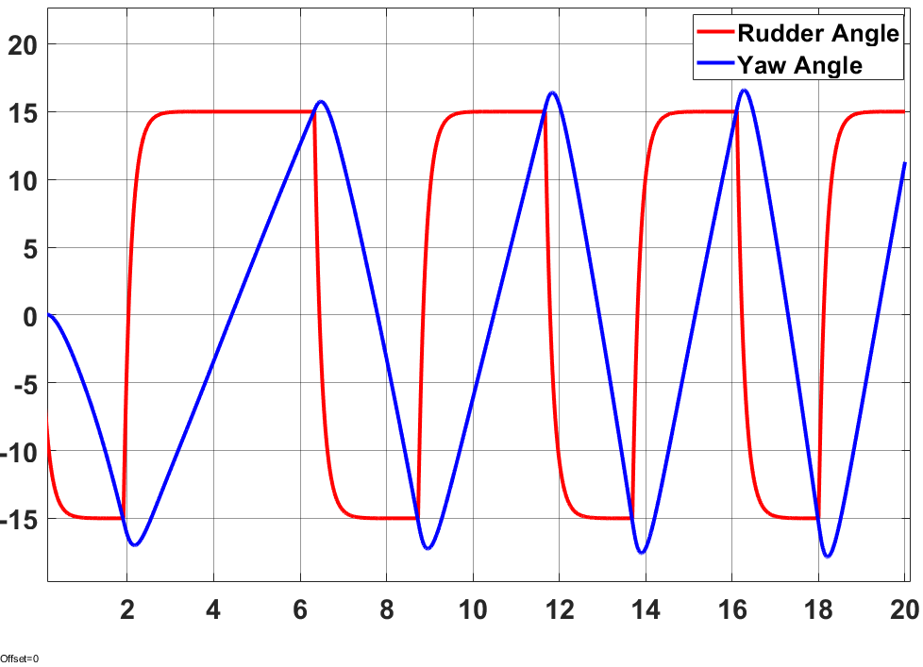
Motion Control: Steering Controller
Zig-Zag Test
K = 2.6005 & T = 0.4364
Introduction
Overview
Sailboat Simulation
Motion Control
Future Work

Slide 20
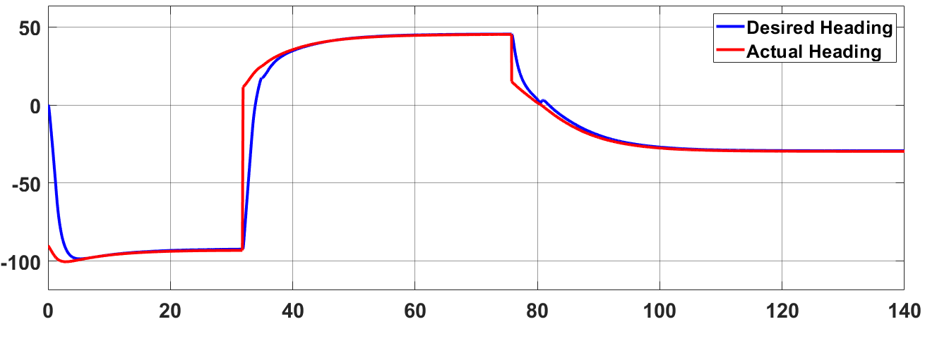
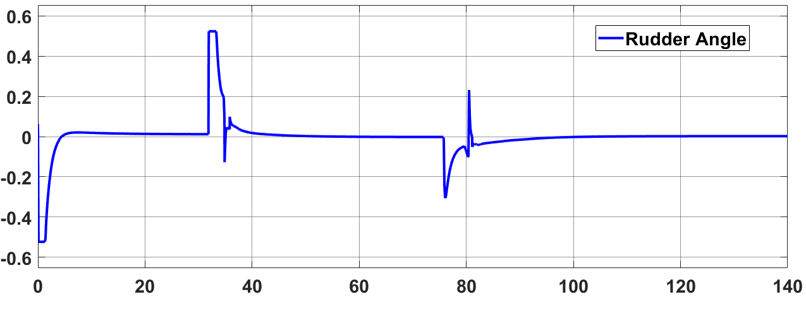
Motion Control: Steering Controller
Introduction
Overview
Sailboat Simulation
Motion Control
Future Work

Slide 21
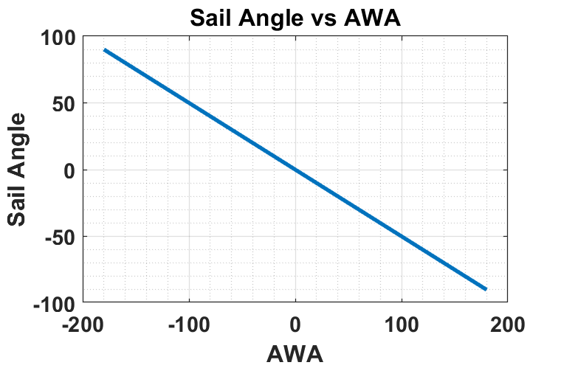

Motion Control: Sail Angle Reference
Control objective is to achieve maximum forward propulsion for a given wind angle
Find maximum value for Fs with varying ${\text{δ}}_{s}$ (sail angle)
${\text{ψ}}_{aω}$ = $\text{ψ}\text{ − }{\text{ψ}}_{ω}−π$
$F_{s}=sin\left(δ_{s}−{\text{ψ}}_{aω}\right)sin⁡(δ_{s}$)
Solution: $δ_{s}=−0.5 ∗ {\text{ψ}}_{aw}$ + a*φ ( -180 < ${\text{ψ}}_{aw}$ < 180, -60 < $δ_{s}$ < 60)
Introduction
Overview
Sailboat Simulation
Motion Control
Future Work

Slide 22
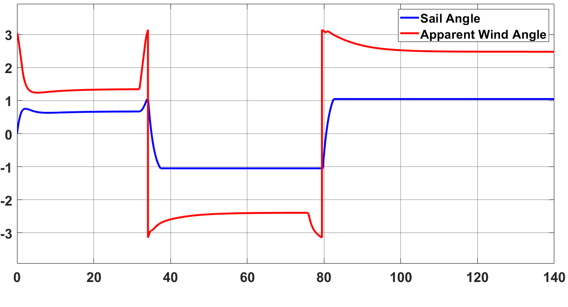
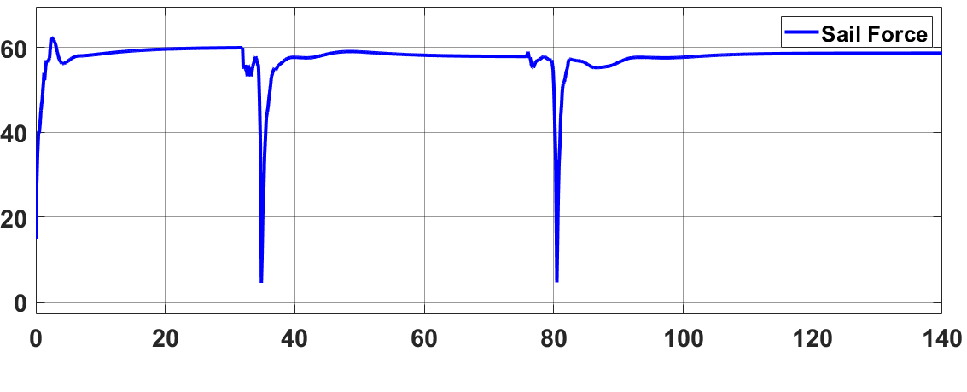
Motion Control: Sail Angle Reference
Introduction
Overview
Sailboat Physics
Motion Control
Future Work

Slide 23
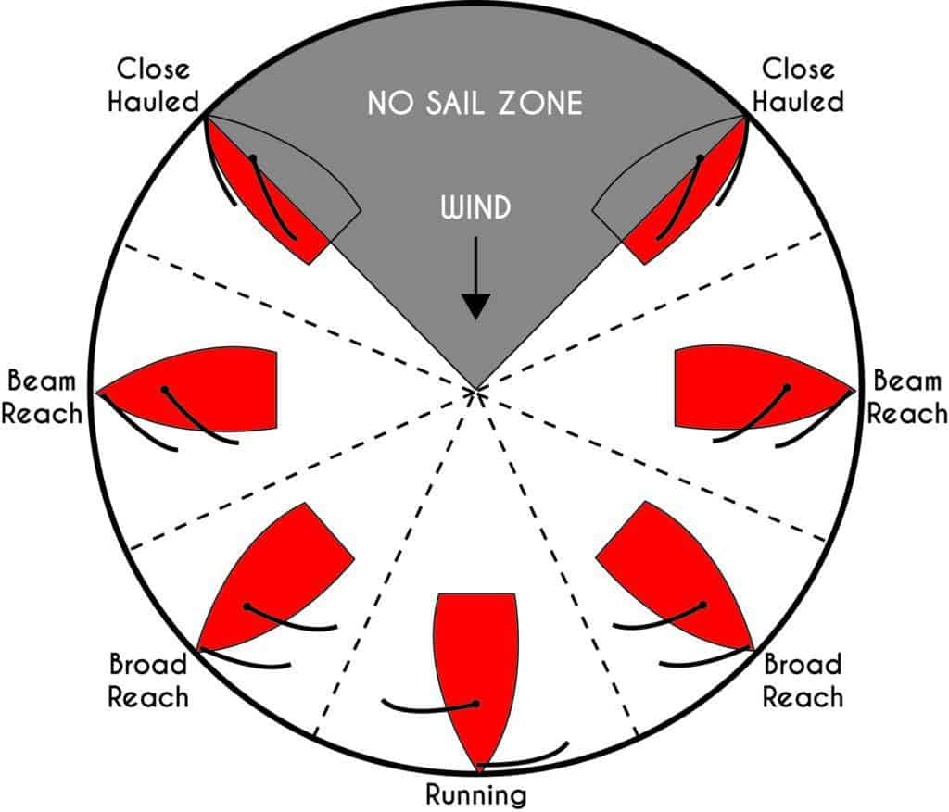
Motion Control: Tacking Controller
Required to sail into the wind
3 Tacking Controllers
Direct Tack
Indirect Tack
Zone Tacking
Tacking Controller feeds heading angle into Heading Controller
Introduction
Overview
Sailboat Simulation
Motion Control
Future Work

Slide 24
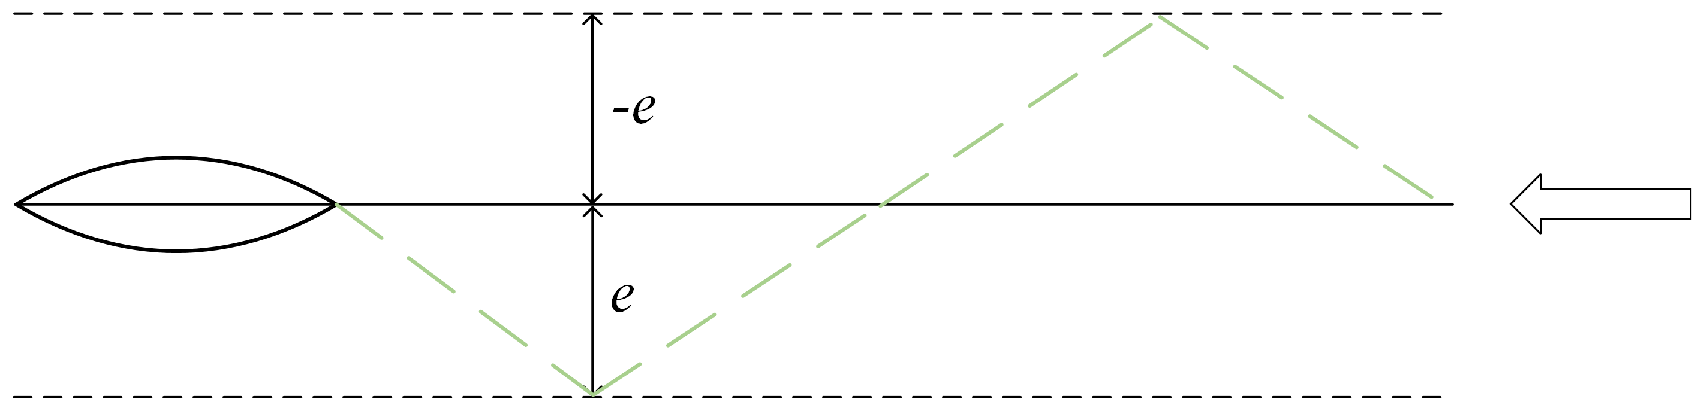
Motion Control: Direct Tack
Direct Tack is defined as a tack maneuver were the cross-track error determines what side the sailboat should tack
Introduction
Overview
Sailboat Simulation
Motion Control
Future Work

Slide 25
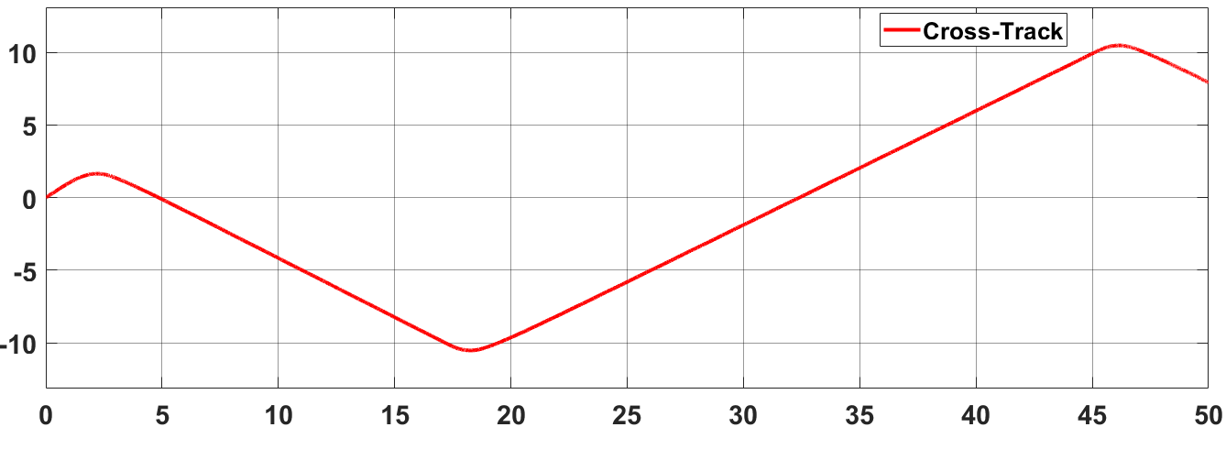
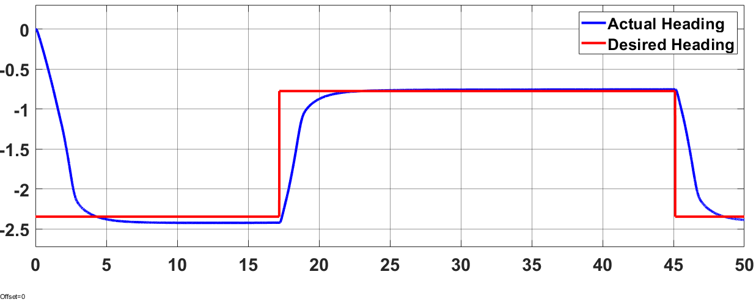
Motion Control: Direct Tack
Introduction
Overview
Sailboat Simulation
Motion Control
Future Work

Slide 26
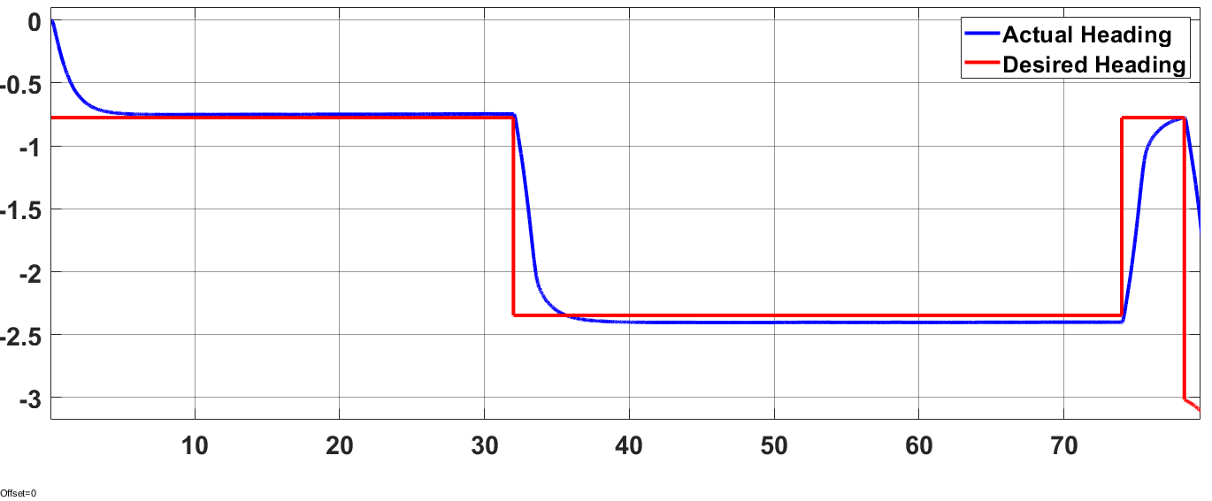

Motion Control: Indirect Tack
Indirect Tack is defined as the maneuver when the sailboat aims to only tack once
This is achieved by sailing out to the lay line and once the lay line is reached tack back to the waypoint
$\text{ϴ}=\tan^{−1}{\frac{Cross Track Distance}{Distance to Waypotin}}$
Switch Tack when ϴ = 45
Introduction
Overview
Sailboat Simulation
Motion Control
Future Work

Slide 27
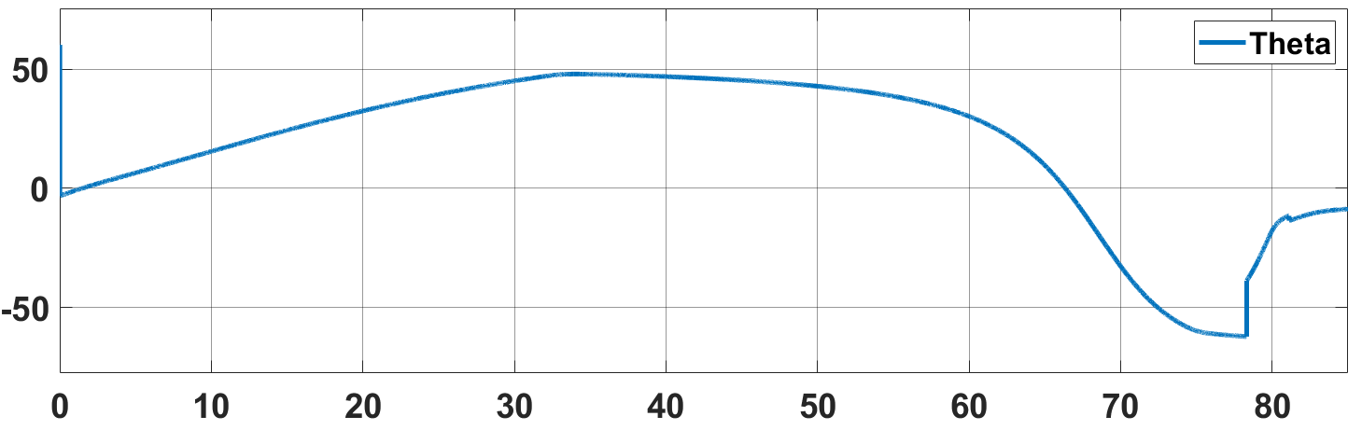
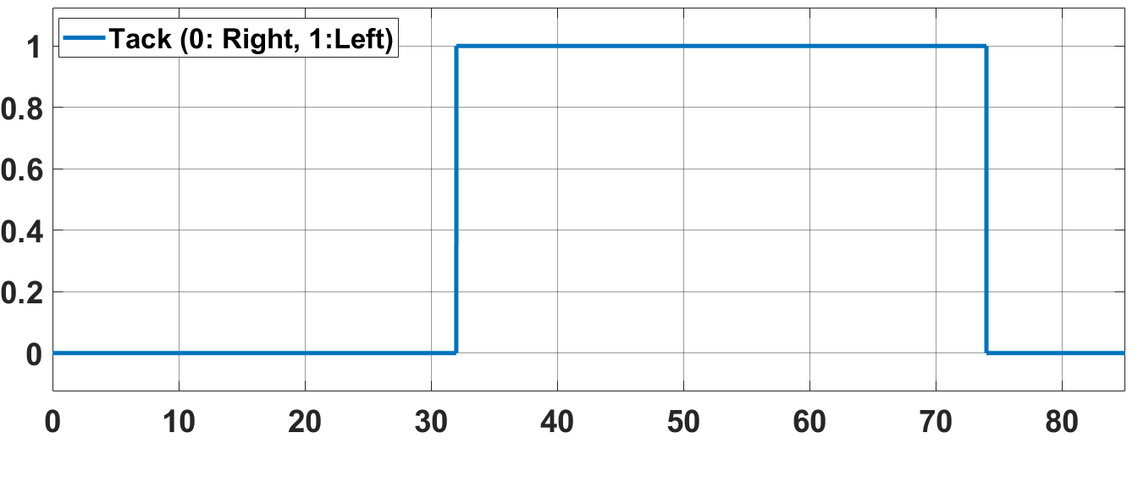
Motion Control: Indirect Tack
Introduction
Overview
Sailboat Simulation
Motion Control
Future Work

Slide 28
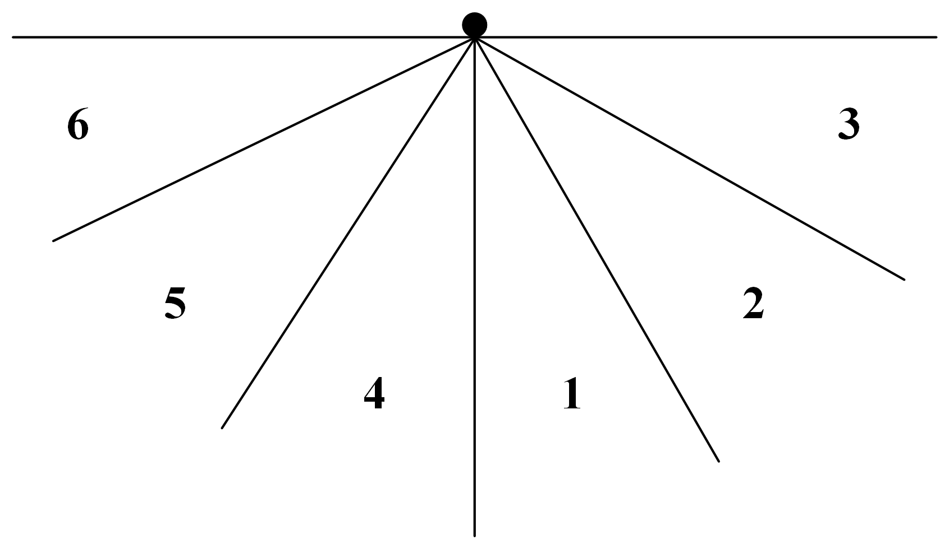
Motion Control: Zone Tack
Zone/Dynamic tack considers the wind angle when tacking
A tack switch is only performed when the wind forces it
Define zones 1-6, sailboat tries to remain inside zones 1,2,4 and 5 when tacking
Zones are calculated by the waypoint heading and wind angle
Introduction
Overview
Sailboat Simulation
Motion Control
Future Work

